Slide 1


PRODUCTION MANAGEMENT
NAME: Mehta Jay
CLASS: SY IT-1
SUBJECT: ENGINEERING ECONOMICS AND MANAGEMENT
EN NO. : 1604101158

Slide 2
INTRODUCTION
It is defined as planning,, implementation and control of industrial production process to ensure smooth and efficient operation. Production Management techniques are used in both manufacturing and service industries.
Simply Production Management is a process of planning, organizing, directing and controlling the activities of the production function.

Slide 3
CONCEPT OF PRODUCTION
Production is defined as “the step-by-step conversion of one form of material ino another form through chemical or mechanical process to create or enhance the utility of the product to the user.”
Thus production is a value addition process. At each stage of processing, there will be value addition.
Edwood Buffa defines production as ‘a process by which goods and services are created.’

Slide 4
EXAMPLE OF PRODUCTION
Car
Bus
Textile
Food
Machines
Electronics
Constructing flats

Slide 5
PRODUCTION SYSTEM
The production system of an organization is that part which produces products of an organization.
It is that activity whereby resources, flowing within a defined system are combined and transformed in a controlled manner to add value in accordance with the policies communicated by management.

Slide 6
INPUT:
Men
Machine
Materials
Information
Capital
TRANSFORMATION
PROCESS:
Product design
Process planning
Production control
Maintenance
OUTPUTS:
Product
Services
CONTINUOUS:
Inventory
Quality
Cost

Slide 7
OBJECTIVES OF PRODUCTION MANGEMENT
The objective of the production management is to,” Produce goods and services of a right quality and quantity at the right time and right manufacturing cost.”

Slide 8
RIGHT QUALITY
The quality of the product is based upon the customers need. The right quality is not necessarily best quality. It is determined by the cost of the product and the technical characteristics as suited to the specific requirements.

Slide 9
RIGHT QUANTITY
The manufacturing organization should produce the products in right number. If they are producing in the excess of demand, the capital will block up in the form of inventory and if the quantity is produced in the short of demand, leads to the shortage of products.

Slide 10
RIGHT TIME
Time of the delivery is one of the important parameter to judge the effectiveness of the production department. So, if the production department has to make the optimal utilization of input resources to achieve its objective.
RIGHT MANUFACTURING COST
Manufacturing cost is established before the product is actually manufactured.
All attempts should be made to produce the product at pre-established cost.

Slide 11
SCOPE OF THE PRODUCTION MANAGEMENT
It is concern with the conversion of inputs into outputs, using physical resources. So as to provide desired utilities to the customer while meeting the other organizational objectives of effectiveness, efficiency and adoptibility.

Slide 12
Following are the activities which are listed under production management functions:
Location of facilities
Plan of layouts
Product design
Process design
Production and planning control
Quality control
Material management
Maintenance management

Slide 13
A case study of high welfare milk production in India

Slide 14
India is the world’s largest single milk producer, with a total of 132.4 million tons of liquid milk produced in 2012-2013.1 Livestock production is the most important agricultural activity in the country, contributing about 24.8% to the agricultural gross domestic product.
The value of India’s milk output during 2012-2013 has been estimated at over Rs.2,900 billion (approximately US$ 45 billion), higher than the combined value of other major agricultural crops like paddy, wheat and sugarcane.

Slide 15
Dairy farming dominates livestock production, providing 18 million people, 70 per cent of them women, with employment. The dairy sector is also the major source of income for an estimated 27.6
million people
The majority of milk production is still carried out by small-scale, often landless farmers, who get a large share of the total price paid by consumers (77 per cent). In comparison, producers in Germany only receive 48 per cent and in the United States only 45 per cent of the total price.4 This makes milk production very attractive; it offers many of India’s farmers a way out of poverty.

Slide 16
An overview of the Kisan Dairy farm.
Kisan Dairy is owned by the Kumar family and is located in Tarawadi, an agricultural hub in the state of Haryana.
The dairy started in 1987 with 20 cows – 10 indigenous and 10 Holstein Friesian crosses. It has been growing ever since and in 2014 had 90 dairy cows and a total of 222 cattle, the vast majority of which are cross bred for better suitability to the hot and humid local conditions.

Slide 17
Milking is carried out using portable milking machines twice a day.
The workers clean the cows’ teats before attaching the machine to the udders and afterwards apply an approved anti-bacterial solution.
It takes two hours to complete one milking cycle with five milking machines.
Kisan Dairy employs four family members and 12 other people recruited locally who are responsible for milk production as well as the marketing of the milk in the local village.
The marketing model is similar to many other dairy ,the milk is sold directly to consumers twice a day at the farm gate and at sales points in the village. As of May 2014, the price of milk is Rs.34 per litre.

Slide 18
Management and veterinary practice
The farm employs a veterinarian who visits the farm most evenings. In his absence, Naresh Kumar carries out inspections, vaccinations, de-worming and artificial insemination.
Naresh went on a training course conducted by the National Dairy Research Institute (NDRI) in Karnal, where he learned the basics of animal care, artificial nsemination and pregnancy diagnosis.
He keeps in regular contact with this important dairy science institute to keep his knowledge up to date.

Slide 19
Conclusions
Good quality feeding, genetics appropriate to the local conditions and favourable levels of animal care are leading to good health and welfare. This in turn delivers levels of productivity nearly six times higher than the current national average.
Healthy, long-lived cows save on the cost of replacement and expensive veterinary treatments and guarantee a stable milk supply.

Slide 20
The farm uses several by-products from agriculture, ensuring a good use of local resources. This also contributes positively to food security by transforming biomass that is otherwise unusable by humans into milk.
The final destination and the welfare of male dairy calves is a challenging issue that needs to be addressed by the entire dairy industry in collaboration with all interested stakeholders.

Slide 21
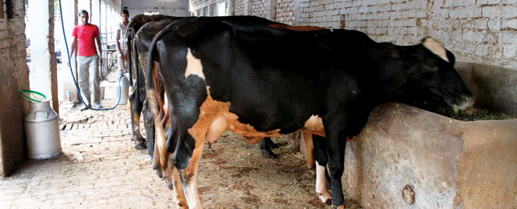

Slide 22
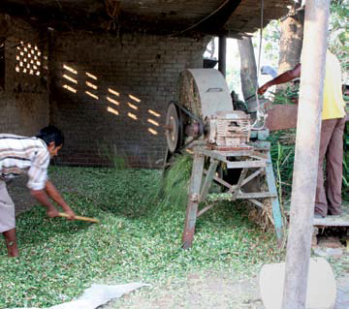
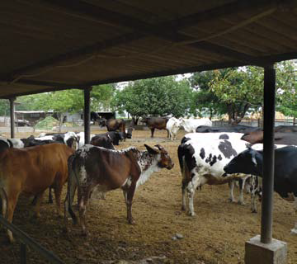

Slide 23
THANK YOU

